Slide 1


Robotics Workshop Week 2 Continuation of Electronics
Notes:
Hello everyone.
Hands up if this is your first robotics session?
For those of you who were here last time, you will be learning about servos and ultrasonic distance sensors.
If this is your first session, you can choose to do last weeks worksheet first or jump straight into today's worksheet.

Slide 2
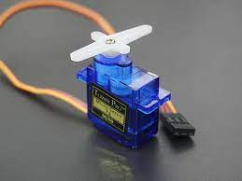
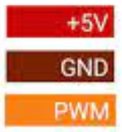
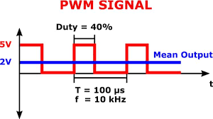
What is a servo?
Notes:
A servo is a type of motor that lets you control its rotational position with a PWM signal.
Where PWM stands for Pulse Width Modulation. Quite simply you are varying how much time a signal is high (at 5V or 3V3) compared to low (0V).
A signal with a 100% duty cycle is always on, so is no different to a power wire. And a signal with a 0% duty cycle is no different to a 0V or ground wire. PWM allows you to mimic voltages in-between by pulsing a mix of high and low signals.
Now an ultrasonic distance sensor sends out a sound wave, and tells you when it receives the echo. This lets you calculate how far an object is by using the time it took for the wave to travel there, reflect, and travel back.

Slide 3
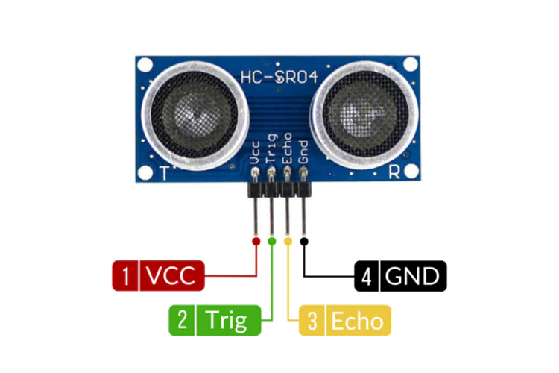
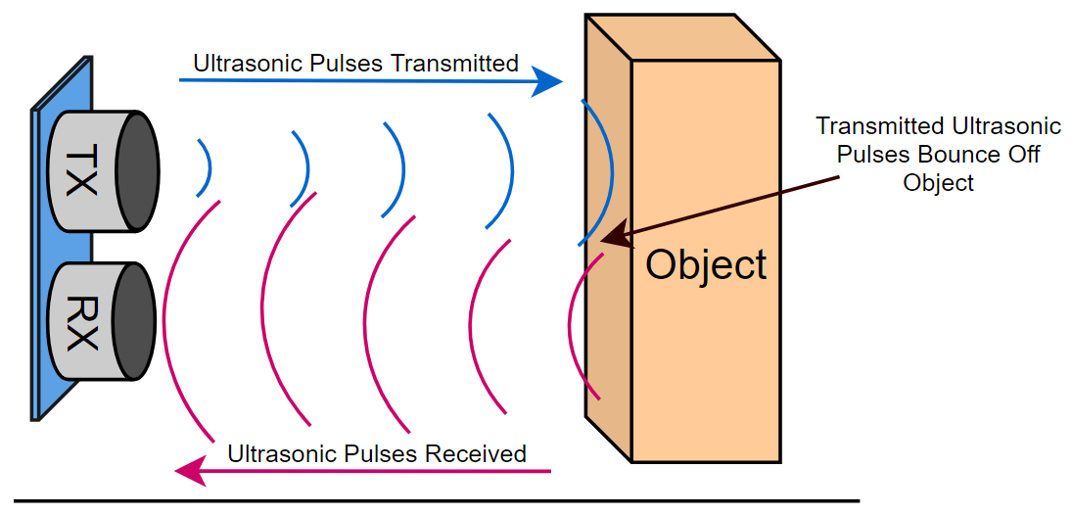
What is an ultrasonic sensor?
Notes:
A servo is a type of motor that lets you control its rotational position with a PWM signal.
Where PWM stands for Pulse Width Modulation. Quite simply you are varying how much time a signal is high (at 5V or 3V3) compared to low (0V).
A signal with a 100% duty cycle is always on, so is no different to a power wire. And a signal with a 0% duty cycle is no different to a 0V or ground wire. PWM allows you to mimic voltages in-between by pulsing a mix of high and low signals.
Now an ultrasonic distance sensor sends out a sound wave and tells you when it receives the echo. This lets you calculate how far an object is by using the time it took for the wave to travel there, reflect, and travel back.
As usual the worksheets go into a lot more detail on how this is implemented, so lets get started.

